Slide 1
Code Transformation
Old -> New via implementing an interface

Slide 2
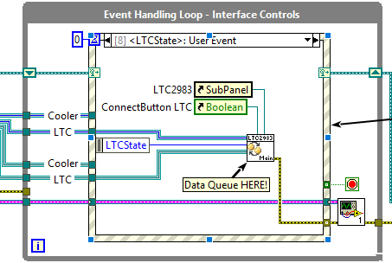
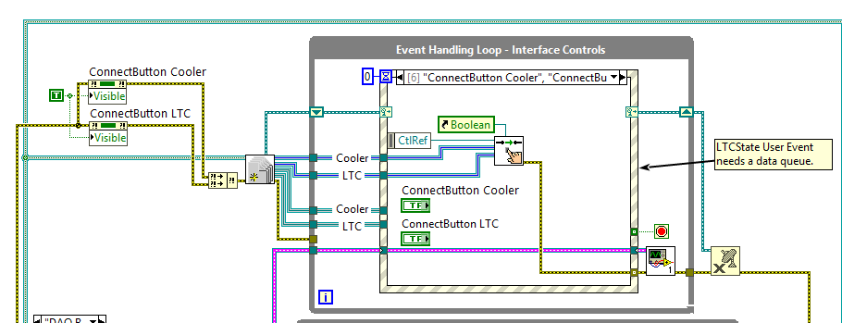
Initially:

Slide 3
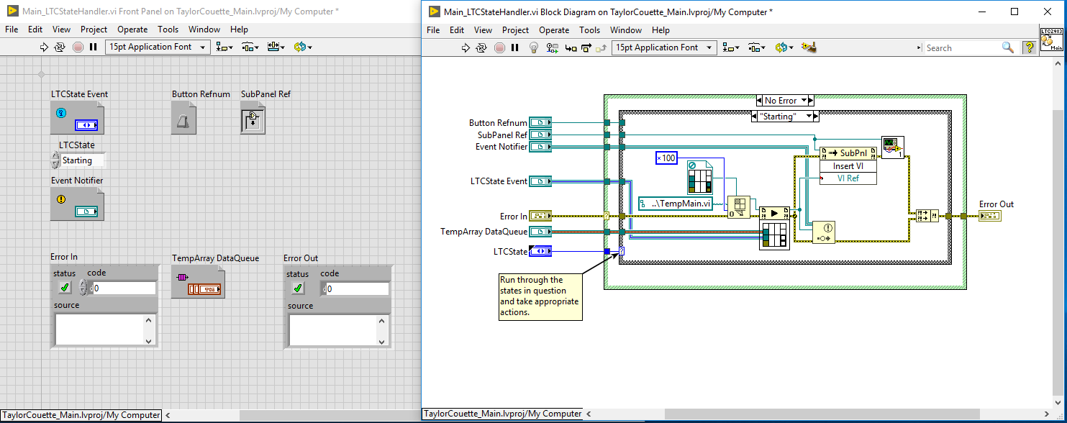
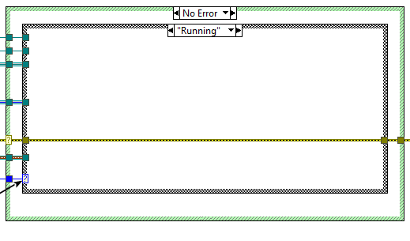
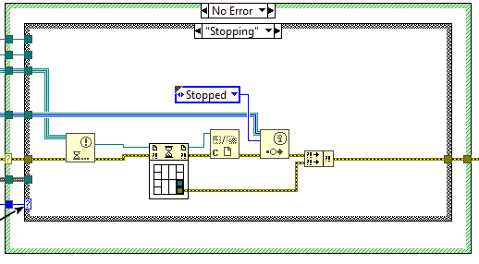
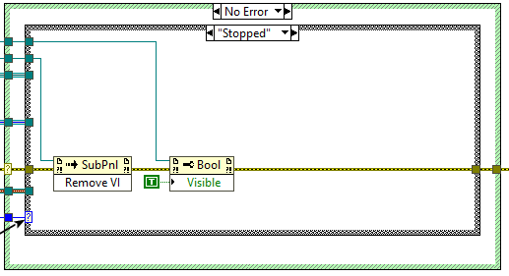

Slide 4
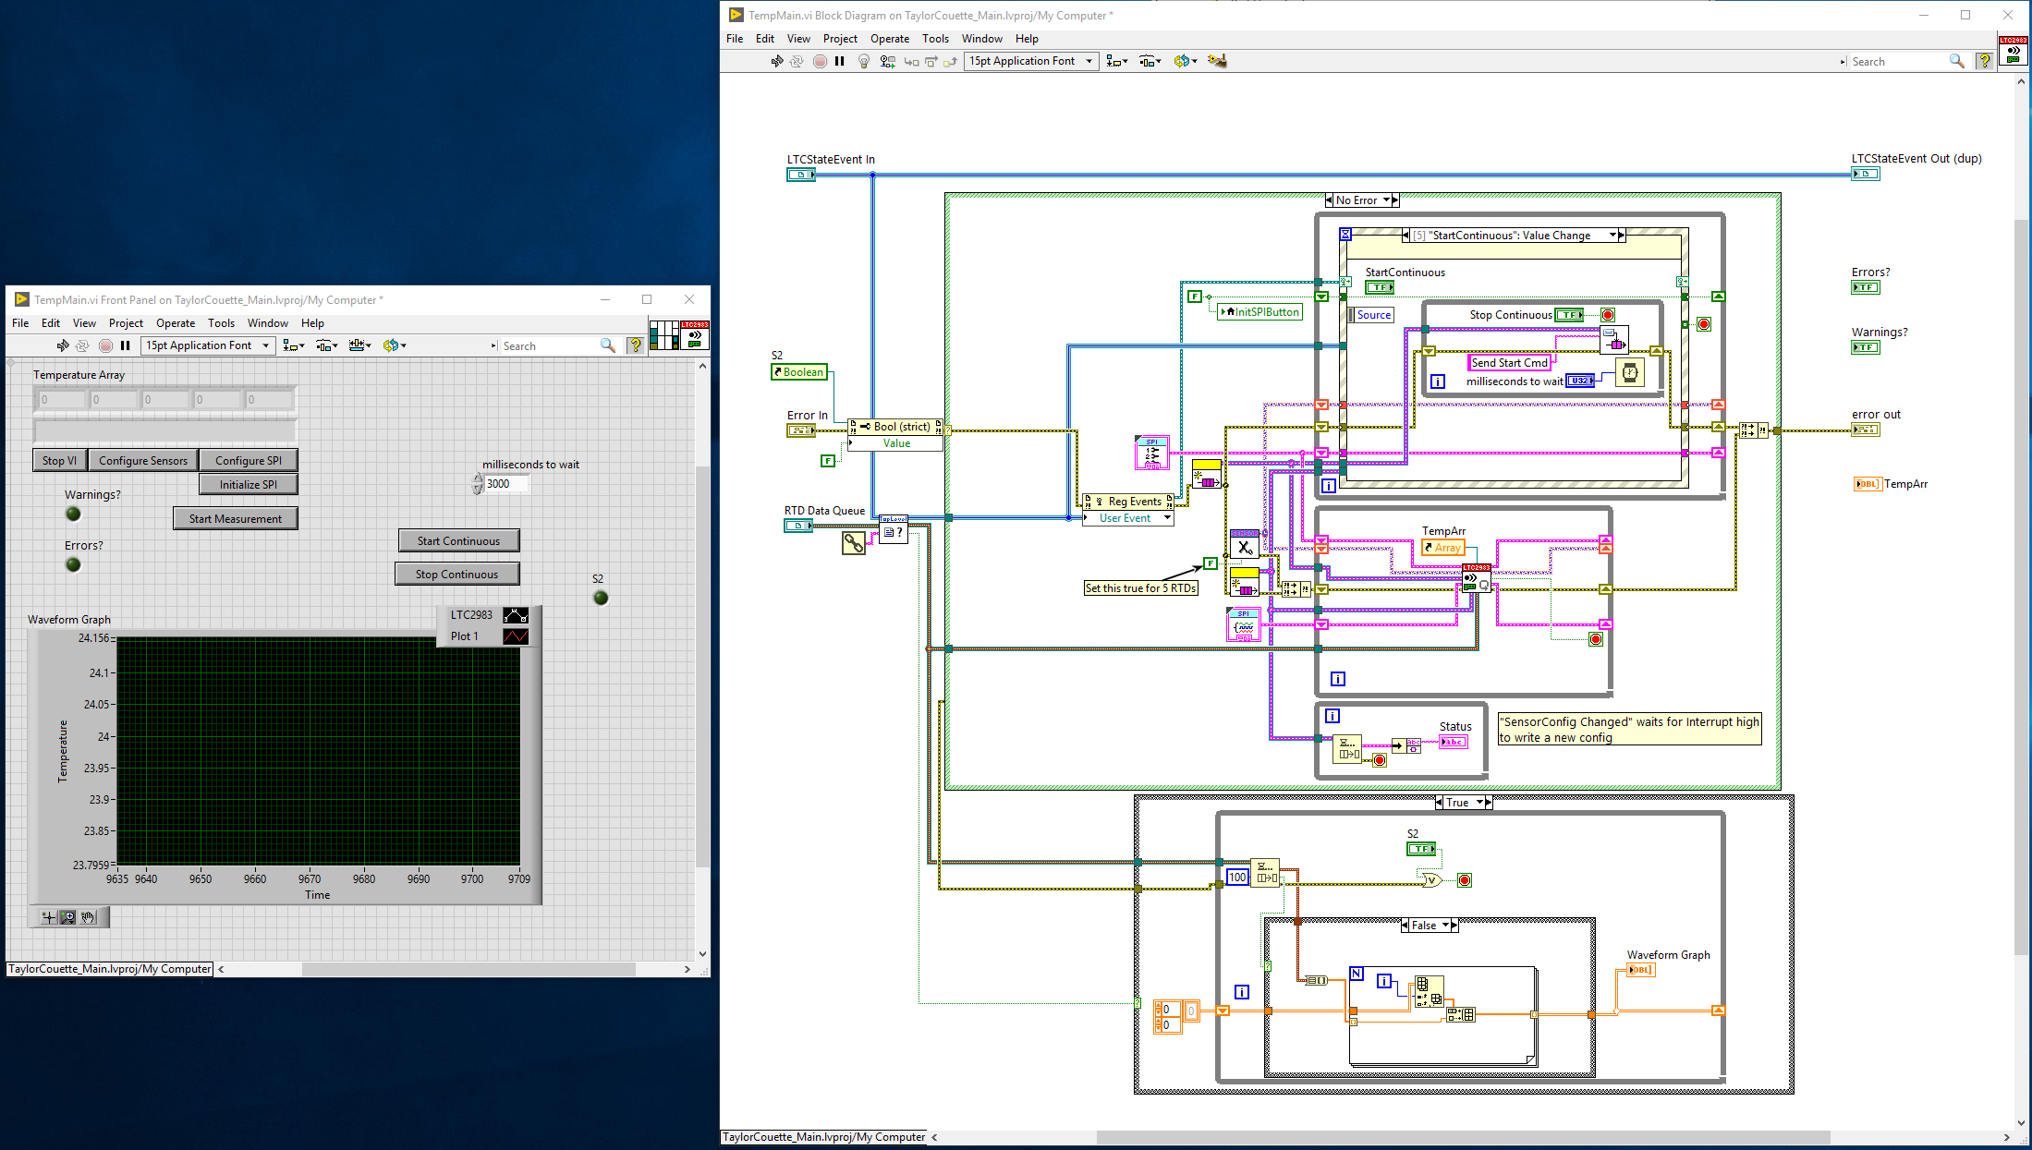

Slide 5
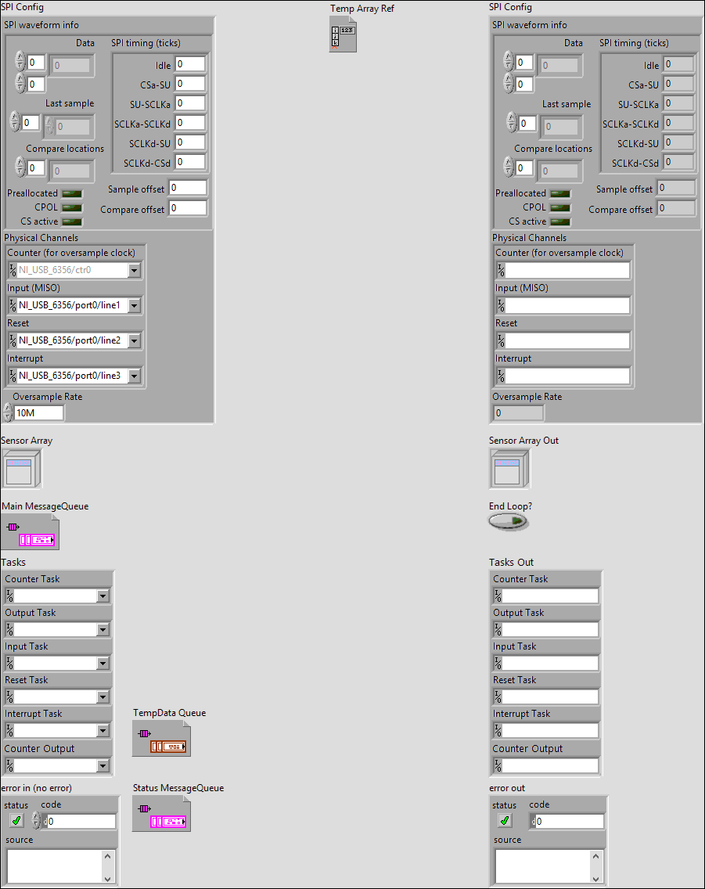
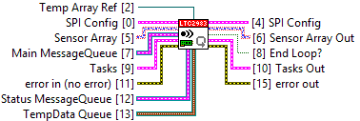

Slide 6
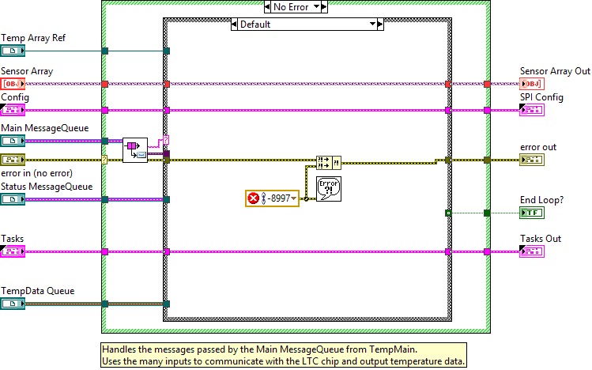
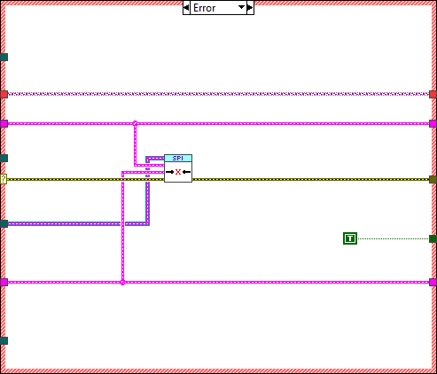
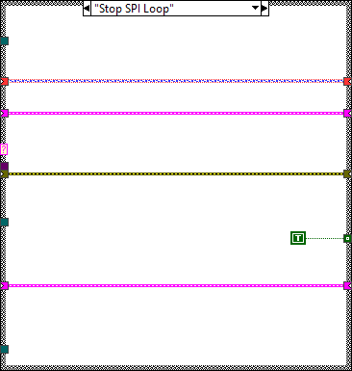

Slide 7
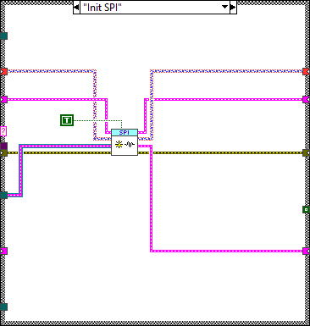
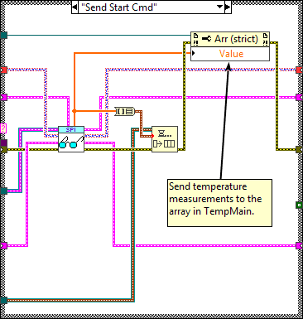
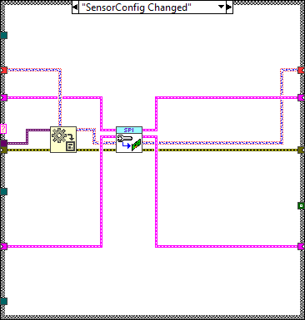
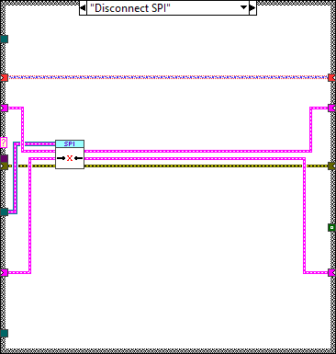
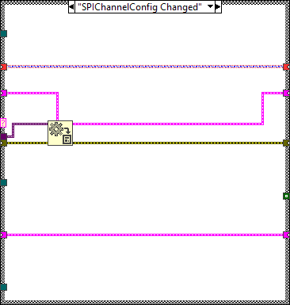

Slide 8
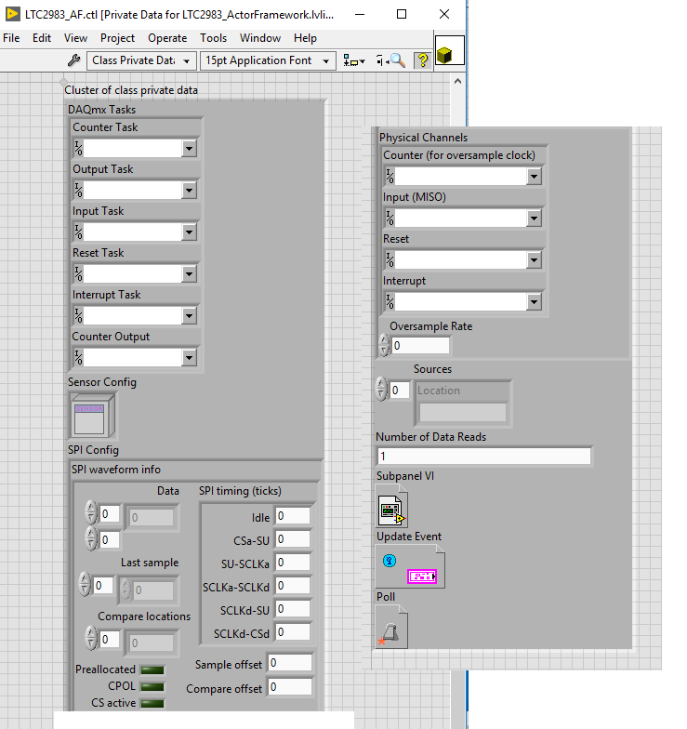
That moved to this: (a thin wrapper)
Moved the previous clusters into the class private data
Created wrappers for each of the main operations
Added some additional code to try and make the measurements more consistent, or to fit into the rest of the new application

Slide 9
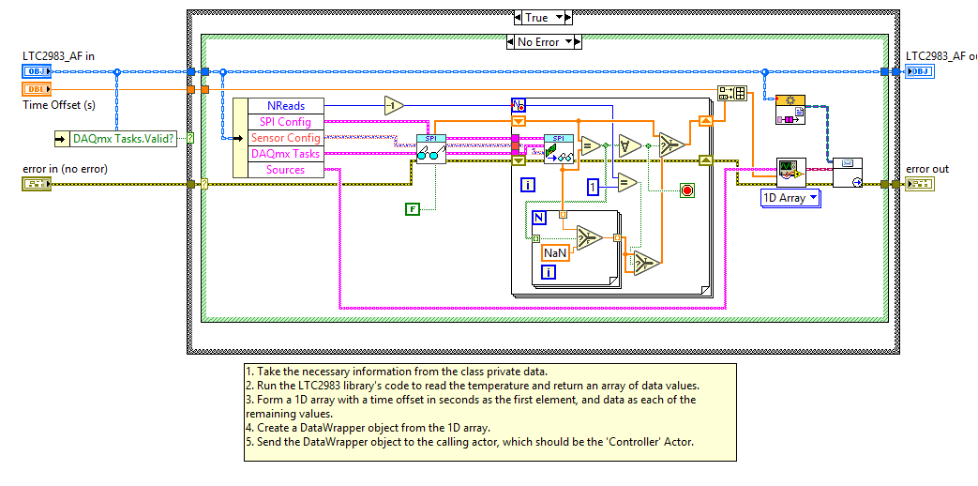
The “Measure Temperature” wrapper

Slide 10
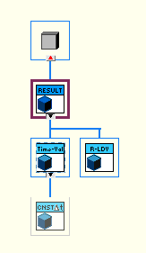
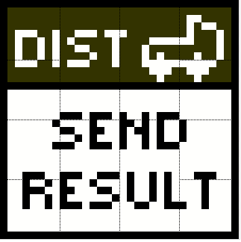
Some supporting pieces:
Measurement Results
The LTC measurement will produce a “Time-Value” result and package with it some information about the measurement, such as time, location and name.
Result Distributor
Initially, I will use a “Distributor” which just wraps the original functionality.
In the future, this inheritance hierarchy will allow me to change the method for passing data, or allow reuse in other systems.

Slide 11
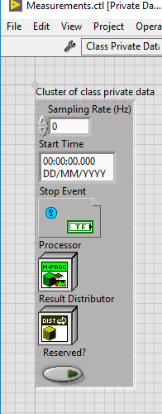
The Measurement Interface
API (public interface):
InitMeasurementActor.vi
SingleMeasurement.vi
StartMeasurement.vi
StopMeasurement.vi
UpdateStartTime.vi (might change this…)
Protected interface:
Process.vi
Read Rate.vi (uncertain…)
RegisterForStop.vi
Reserve.vi
Release.vi
Send Result.vi

Slide 12
First steps…
I moved the code to connect to the hardware into a “Reserve” override, and the code to disconnect into the “Release” override.
This allowed me to delete “Stop Core.vi” and tidy up the beginning of “Actor Core.vi”
It separates out stopping and starting the actor from connecting and disconnecting to the hardware – this makes the code more flexible.
Notes:
Describe the purpose of Stop Core and Actor Core, and the flow of the Actor Framework at a high level (PreLaunchInit, AC, SC)

Slide 13
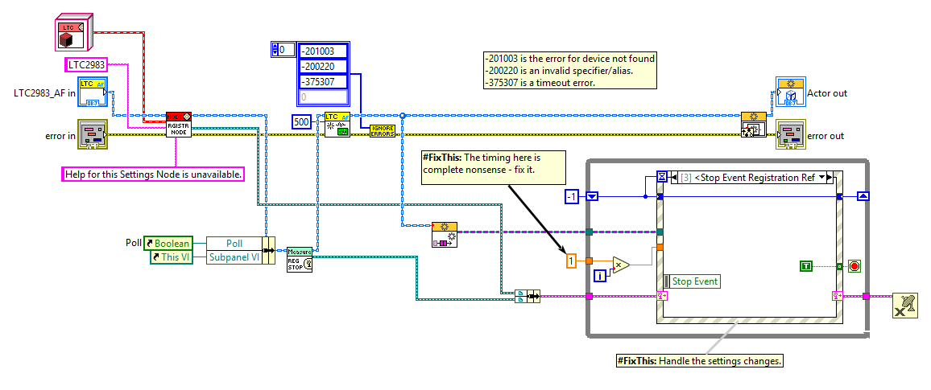
Actor Core.vi
Notes:
Before – the Actor Core VI

Slide 14
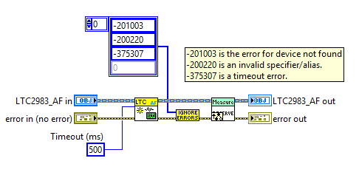
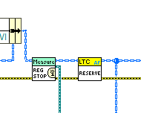
Reserve.vi + calling Reserve from Actor Core
Notes:
Just copied the code from Actor Core into Reserve (created via From Override) and then placed this in the Actor Core.
In this way, it’s only using it as a simple SubVI – done to preserve behaviour.
In future, this can be removed once the VI is called via a hierarchy to make it behave like a Measurement Actor.
There’s an error here – should remove the errors afterwards, or else “Reserved?” will be set to true in the parent unconditionally!

Slide 15
A more complicated transformation…
Next, I want to implement the “SingleMeasurement.vi” override.
This will more-or-less wrap “MeasureTemperature.vi”
Notes:
SingleMeasurement should make a measurement, record the time, and send a Measurement Result object with all the relevant information to the Distributor.
In the starting case, I want to make it behave exactly like it does now!
First, we’ll get rid of the For loop in the middle – this is not relevant to the normal operation and is a lower level construct (like the error codes)
Work through in LabVIEW: start with MeasureTemperature_old.vi and try create a subVI. Note the large number of inputs, and how they’re all available via the class.

Slide 16
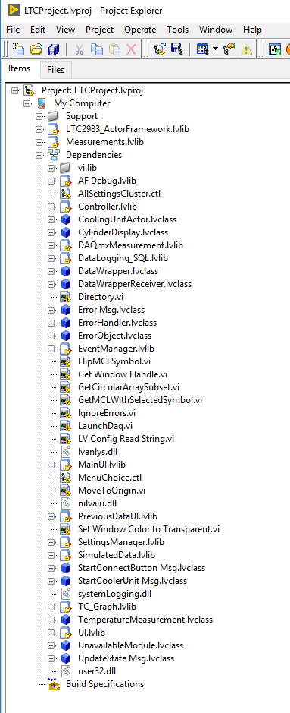
Dependencies of the LTC Actor class
Some highlights:
UI.lvlib
ErrorHandler.lvclass
Controller.lvlib
DataWrapper.lvclass
CoolingUnitActor.lvclass (!!)
LaunchDaq.vi (!!)
SimulatedData.lvlib
Notes:
Some of these are not inherently unreasonable – maybe directly coupling to the Error Handler is OK.
Some are ridiculous! How does LTC depend on a global VI in a different call chain, or SimulatedData/CoolingUnitActor (answer, probably a shared typedef!)
Reducing coupling will improve load times and improve chances of reuse elsewhere (example, a different experiment using the same hardware for this, but changing other parts).

Slide 17
Dependencies of the LTC Actor class
Some highlights:
UI.lvlib
ErrorHandler.lvclass
Controller.lvlib
DataWrapper.lvclass
CoolingUnitActor.lvclass (!!)
LaunchDaq.vi (!!)
SimulatedData.lvlib
Notes:
Some of these are not inherently unreasonable – maybe directly coupling to the Error Handler is OK.
Some are ridiculous! How does LTC depend on a global VI in a different call chain, or SimulatedData/CoolingUnitActor (answer, probably a shared typedef!)
Reducing coupling will improve load times and improve chances of reuse elsewhere (example, a different experiment using the same hardware for this, but changing other parts).

